Slide 1
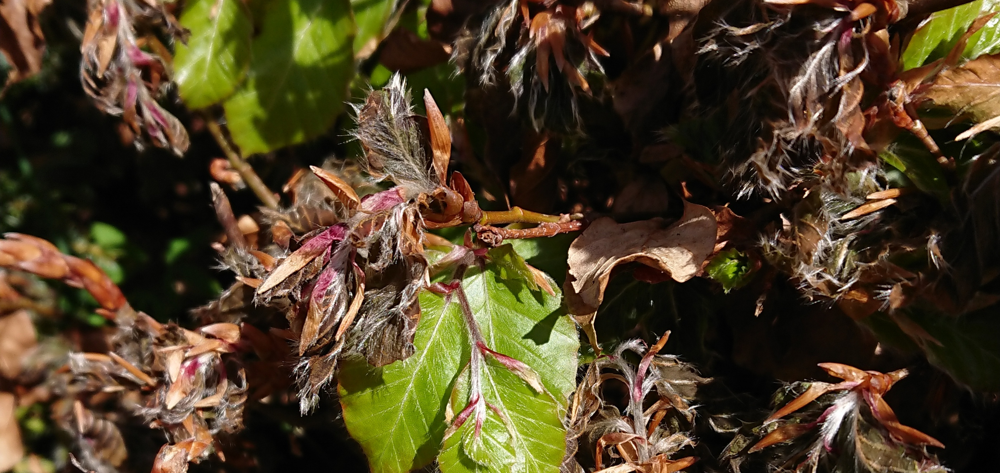
Spatial Genetics of Ecosystems, Department of Geography
Intro to Demographic Simulations
    Billy Wallisch
    16 September 2026
Exposed beech tree in May on Corsica, Meredith C Schuman

Slide 2
Intro
1. Problem
Expensive, noisy data

Slide 3
Intro
1. Problem
2. Solution
Real data
Demographic Simulations

Slide 4
Intro
1. Problem
2. Solution
Real data
Demographic Simulations
3. Method
SLiM: Forward in time genetic simulation

Slide 5

Intro
1. Problem
2. Solution
Real data
Demographic Simulations
3. Method
4. My Project
SLiM: Forward in time genetic simulation
MSc Thesis: $N_{e}$ validation

Slide 6
1. Problem

Slide 7
Problem
Empirical Data
Difficult
Field work
Lab work
Etc.
Notes:
And the barrier to entry is close to zero. A small model runs in seconds on a laptop. A few hundred replicates is an afternoon on any cluster you already have access to. The software is free and open source. There is no permit, no field season, and nothing to put in a budget — which means you can try an idea on a Tuesday and throw it away on a Wednesday. That changes what questions you are willing to ask.

Slide 8
Problem
Empirical Data
Difficult
Slow
Field work
Lab work
Etc.
Data collection
Analysis
Reporting
Notes:
And the barrier to entry is close to zero. A small model runs in seconds on a laptop. A few hundred replicates is an afternoon on any cluster you already have access to. The software is free and open source. There is no permit, no field season, and nothing to put in a budget — which means you can try an idea on a Tuesday and throw it away on a Wednesday. That changes what questions you are willing to ask.

Slide 9
Problem
Empirical Data
Difficult
Slow
Expensive
Field work
Lab work
Etc.
Data collection
Analysis
Reporting
Funding
Equipment
People
Notes:
And the barrier to entry is close to zero. A small model runs in seconds on a laptop. A few hundred replicates is an afternoon on any cluster you already have access to. The software is free and open source. There is no permit, no field season, and nothing to put in a budget — which means you can try an idea on a Tuesday and throw it away on a Wednesday. That changes what questions you are willing to ask.

Slide 10
Problem
Empirical Data
Difficult
Slow
Expensive
Field work
Lab work
Etc.
Data collection
Analysis
Reporting
Funding
Equipment
People
Pro: True by construction
Con: Snapshot of system
Notes:
And the barrier to entry is close to zero. A small model runs in seconds on a laptop. A few hundred replicates is an afternoon on any cluster you already have access to. The software is free and open source. There is no permit, no field season, and nothing to put in a budget — which means you can try an idea on a Tuesday and throw it away on a Wednesday. That changes what questions you are willing to ask.

Slide 11
Problem
Sample 10 individuals

Slide 12
Problem
Sample 10 individuals
10 Genomes Sequenced

Slide 13
Problem
Sample 10 individuals
10 Genomes Sequenced
Allele Frequencies, at one point in time

Slide 14
2. Solution

Slide 15
Solution
Demographic Simulations
Accessible
Computer access
Software
Notes:
And the barrier to entry is close to zero. A small model runs in seconds on a laptop. A few hundred replicates is an afternoon on any cluster you already have access to. The software is free and open source. There is no permit, no field season, and nothing to put in a budget — which means you can try an idea on a Tuesday and throw it away on a Wednesday. That changes what questions you are willing to ask.

Slide 16
Solution
Demographic Simulations
Accessible
Fast
Computer access
Software
Easy to learn
Minutes to run
Notes:
And the barrier to entry is close to zero. A small model runs in seconds on a laptop. A few hundred replicates is an afternoon on any cluster you already have access to. The software is free and open source. There is no permit, no field season, and nothing to put in a budget — which means you can try an idea on a Tuesday and throw it away on a Wednesday. That changes what questions you are willing to ask.

Slide 17
Solution
Demographic Simulations
Accessible
Fast
Free
Computer access
Software
Easy to learn
Minutes to run
Open-source code
Free to use and learn
Notes:
And the barrier to entry is close to zero. A small model runs in seconds on a laptop. A few hundred replicates is an afternoon on any cluster you already have access to. The software is free and open source. There is no permit, no field season, and nothing to put in a budget — which means you can try an idea on a Tuesday and throw it away on a Wednesday. That changes what questions you are willing to ask.

Slide 18
Solution
Demographic Simulations
Accessible
Fast
Free
Computer access
Software
Easy to learn
Minutes to run
Ask a question without using funding
Free to use and learn
Con: only as good as your parameters
Notes:
And the barrier to entry is close to zero. A small model runs in seconds on a laptop. A few hundred replicates is an afternoon on any cluster you already have access to. The software is free and open source. There is no permit, no field season, and nothing to put in a budget — which means you can try an idea on a Tuesday and throw it away on a Wednesday. That changes what questions you are willing to ask.

Slide 19
Solution

Slide 20
Solution
Record all individuals

Slide 21
Solution
Record all individuals
Every genome maintained

Slide 22
Solution
Record all individuals
Every genome maintained
Every genome, of every individual, over thousands of generations

Slide 23
Solution
Notes:
Be honest about this, because someone will raise it if you are not. Real data is true — that is its entire advantage, and it is a big one. Simulated data is only ever as good as the assumptions you put in. But they are not rivals. Your field data is what sets the parameters, and the simulation is what tells you which measurement would actually be worth the field season. And when the model reproduces something you already observed, that is a check on the model. They strengthen each other.

Slide 24
Problem

Slide 25
Problem
True by construction
Real
data
Signal : Noise
Snapshot

Slide 26
Problem
True by construction
Real
data
Cheap and fast
Signal : Noise
Context using real data
Simulated
data
Complete and replicated
Snapshot

Slide 27
Problem
True by construction
Real
data
Cheap and fast
Signal : Noise
Context using real data
Simulated
data
Complete and replicated
Snapshot
Field data informs assumptions.
Simulation informs field data.

Slide 28
3.Method

Slide 29
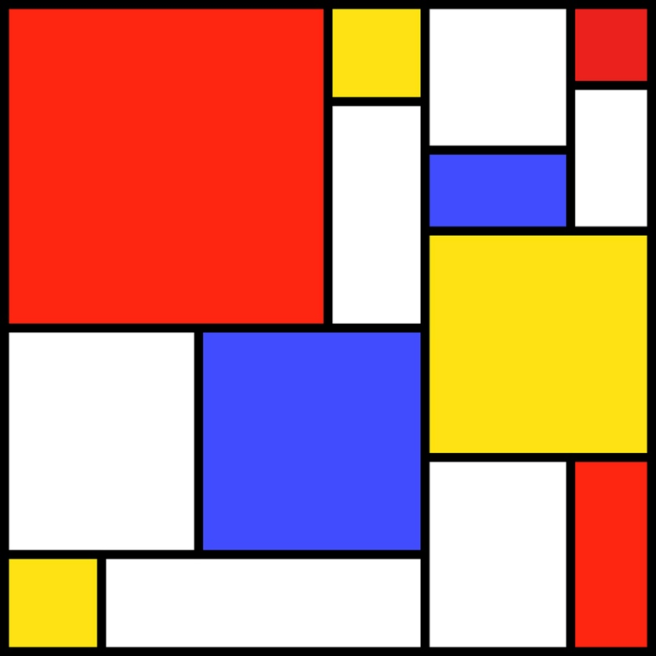

Notes:
SLiM is a free, open-source evolutionary simulation framework that combines a powerful engine for population genetic simulations with the capability of modelling arbitrarily complex evolutionary scenarios. Simulations are configured via the integrated Eidos scripting language that allows interactive control over practically every aspect of the simulated evolutionary scenarios. The underlying individual-based simulation engine is highly optimized to enable modelling of entire chromosomes in large populations.

Slide 30


Slide 31
Benjamin C. Haller and Philipp W. Messer
Dept. of Computational Biology Cornell University

Slide 32
Benjamin C. Haller and Philipp W. Messer
Dept. of Computational Biology Cornell University
Online/in person workshops
Manuals
GitHub

Slide 33
Method
Gen 1

Slide 34
Method
Gen 1

Slide 35
Method
Gen 1
Gen 2

Slide 36
Method
Gen 1
Gen 2

Slide 37
Method
Gen 1
Gen 2
Gen x

Slide 38
Method
R
SLiM
Your data
Your parameters/data
Your script
Your script
Statistics, figures, etc. out
Populations, figures, log files out
Notes:
If you have ever written an R script you already have the mental model. In R you hand it data and a script, and statistics come out — you do not implement the linear algebra yourself. SLiM is the same shape. You hand it parameters and a script, and an evolved population comes out. You do not implement recombination, or mate choice, or fitness calculation. Somebody spent years making that fast and correct so that you do not have to.

Slide 39
Method: what is under the hood
Highly optimized C++ engine
Vectorized
Notes:
Four pieces. Eidos is a small scripting language Haller invented for this — it looks a lot like R. Then a set of built-in objects: subpopulations, mutations, chromosomes, individuals. Underneath that is the C++ core, which is where all the speed lives and which you are never expected to read. And SLiMgui, a window you can watch the whole thing run in. The important line is the bottom one: in practice you only ever write the first.

Slide 40
Method: what is under the hood
Highly optimized C++ engine
Vectorized
Eidos (R based scripting language)
Built in objects
Recipe / “cookbook”
Notes:
Four pieces. Eidos is a small scripting language Haller invented for this — it looks a lot like R. Then a set of built-in objects: subpopulations, mutations, chromosomes, individuals. Underneath that is the C++ core, which is where all the speed lives and which you are never expected to read. And SLiMgui, a window you can watch the whole thing run in. The important line is the bottom one: in practice you only ever write the first.

Slide 41
Method: what is under the hood
Power!!
Highly optimized C++ engine
Vectorized
Eidos (R based scripting language)
Built in objects
Recipe / “cookbook”
Notes:
Four pieces. Eidos is a small scripting language Haller invented for this — it looks a lot like R. Then a set of built-in objects: subpopulations, mutations, chromosomes, individuals. Underneath that is the C++ core, which is where all the speed lives and which you are never expected to read. And SLiMgui, a window you can watch the whole thing run in. The important line is the bottom one: in practice you only ever write the first.

Slide 42
Method: what is under the hood
Power!!
Simplicity
Highly optimized C++ engine
Vectorized
Eidos (R based scripting language)
Built in objects
Recipe / “cookbook”
Notes:
Four pieces. Eidos is a small scripting language Haller invented for this — it looks a lot like R. Then a set of built-in objects: subpopulations, mutations, chromosomes, individuals. Underneath that is the C++ core, which is where all the speed lives and which you are never expected to read. And SLiMgui, a window you can watch the whole thing run in. The important line is the bottom one: in practice you only ever write the first.

Slide 43
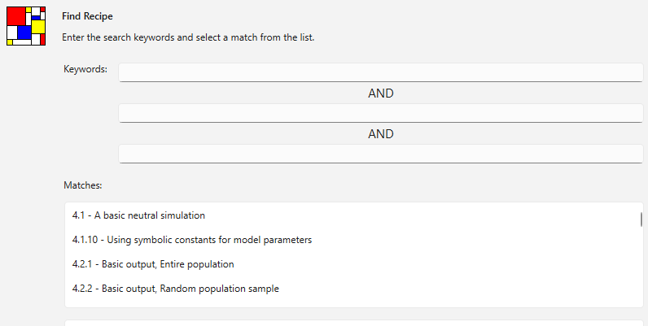
Method

Slide 44
Method
initialize() {
initializeMutationRate(1e-7);
initializeMutationType("m1", 0.5, "f", 0.0);
initializeGenomicElementType("g1", m1, 1.0);
initializeGenomicElement(g1, 0, 99999);
initializeRecombinationRate(1e-8);
}
1 early() {
sim.addSubpop("p1", 500);
}
10000 early() {
sim.simulationFinished();
}
SLiM manual §4.1, the basic neutral simulation recipe.
Notes:
This is not a simplified teaching example — it is recipe 4.1 from the manual, and it runs. Five lines set up the genetics: a mutation rate, one kind of mutation, what the chromosome is made of, how long it is, and how often it recombines. One line makes five hundred individuals. One line stops it after ten thousand generations. That is a complete population-genetic simulation. Everything I do in my own project is this, with more lines.

Slide 45
Method
initialize() {
initializeMutationRate(1e-7);
initializeMutationType("m1", 0.5, "f", 0.0);
initializeGenomicElementType("g1", m1, 1.0);
initializeGenomicElement(g1, 0, 99999);
initializeRecombinationRate(1e-8);
}
1 early() {
sim.addSubpop("p1", 500);
}
10000 early() {
sim.simulationFinished();
}
SLiM manual §4.1, the basic neutral simulation recipe.
Notes:
This is not a simplified teaching example — it is recipe 4.1 from the manual, and it runs. Five lines set up the genetics: a mutation rate, one kind of mutation, what the chromosome is made of, how long it is, and how often it recombines. One line makes five hundred individuals. One line stops it after ten thousand generations. That is a complete population-genetic simulation. Everything I do in my own project is this, with more lines.

Slide 46
Method
initialize() {
initializeMutationRate(1e-7);
initializeMutationType("m1", 0.5, "f", 0.0);
initializeGenomicElementType("g1", m1, 1.0);
initializeGenomicElement(g1, 0, 99999);
initializeRecombinationRate(1e-8);
}
1 early() {
sim.addSubpop("p1", 500);
}
10000 early() {
sim.simulationFinished();
}
SLiM manual §4.1, the basic neutral simulation recipe.
Notes:
This is not a simplified teaching example — it is recipe 4.1 from the manual, and it runs. Five lines set up the genetics: a mutation rate, one kind of mutation, what the chromosome is made of, how long it is, and how often it recombines. One line makes five hundred individuals. One line stops it after ten thousand generations. That is a complete population-genetic simulation. Everything I do in my own project is this, with more lines.

Slide 47
Method
initialize() {
initializeMutationRate(1e-7);
initializeMutationType("m1", 0.5, "f", 0.0);
initializeGenomicElementType("g1", m1, 1.0);
initializeGenomicElement(g1, 0, 99999);
initializeRecombinationRate(1e-8);
}
1 early() {
sim.addSubpop("p1", 500);
}
10000 early() {
sim.simulationFinished();
}
SLiM manual §4.1, the basic neutral simulation recipe.
Notes:
This is not a simplified teaching example — it is recipe 4.1 from the manual, and it runs. Five lines set up the genetics: a mutation rate, one kind of mutation, what the chromosome is made of, how long it is, and how often it recombines. One line makes five hundred individuals. One line stops it after ten thousand generations. That is a complete population-genetic simulation. Everything I do in my own project is this, with more lines.

Slide 48
Method
initialize() {
initializeMutationRate(1e-7);
initializeMutationType("m1", 0.5, "f", 0.0);
initializeGenomicElementType("g1", m1, 1.0);
initializeGenomicElement(g1, 0, 99999);
initializeRecombinationRate(1e-8);
}
1 early() {
sim.addSubpop("p1", 500);
}
10000 early() {
sim.simulationFinished();
}
SLiM manual §4.1, the basic neutral simulation recipe.
Notes:
This is not a simplified teaching example — it is recipe 4.1 from the manual, and it runs. Five lines set up the genetics: a mutation rate, one kind of mutation, what the chromosome is made of, how long it is, and how often it recombines. One line makes five hundred individuals. One line stops it after ten thousand generations. That is a complete population-genetic simulation. Everything I do in my own project is this, with more lines.

Slide 49
Method
initialize() {
initializeMutationRate(1e-7);
initializeMutationType("m1", 0.5, "f", 0.0);
initializeGenomicElementType("g1", m1, 1.0);
initializeGenomicElement(g1, 0, 99999);
initializeRecombinationRate(1e-8);
}
1 early() {
sim.addSubpop("p1", 500);
}
10000 early() {
sim.simulationFinished();
}
SLiM manual §4.1, the basic neutral simulation recipe.
Notes:
This is not a simplified teaching example — it is recipe 4.1 from the manual, and it runs. Five lines set up the genetics: a mutation rate, one kind of mutation, what the chromosome is made of, how long it is, and how often it recombines. One line makes five hundred individuals. One line stops it after ten thousand generations. That is a complete population-genetic simulation. Everything I do in my own project is this, with more lines.

Slide 50
Method
initialize() {
initializeMutationRate(1e-7);
initializeMutationType("m1", 0.5, "f", 0.0);
initializeGenomicElementType("g1", m1, 1.0);
initializeGenomicElement(g1, 0, 99999);
initializeRecombinationRate(1e-8);
}
1 early() {
sim.addSubpop("p1", 500);
}
10000 early() {
sim.simulationFinished();
}
500 individuals.
100,000 bp chromosome.
Neutral mutation
10,000 generations.
SLiM manual §4.1, the basic neutral simulation recipe.
Notes:
This is not a simplified teaching example — it is recipe 4.1 from the manual, and it runs. Five lines set up the genetics: a mutation rate, one kind of mutation, what the chromosome is made of, how long it is, and how often it recombines. One line makes five hundred individuals. One line stops it after ten thousand generations. That is a complete population-genetic simulation. Everything I do in my own project is this, with more lines.

Slide 51
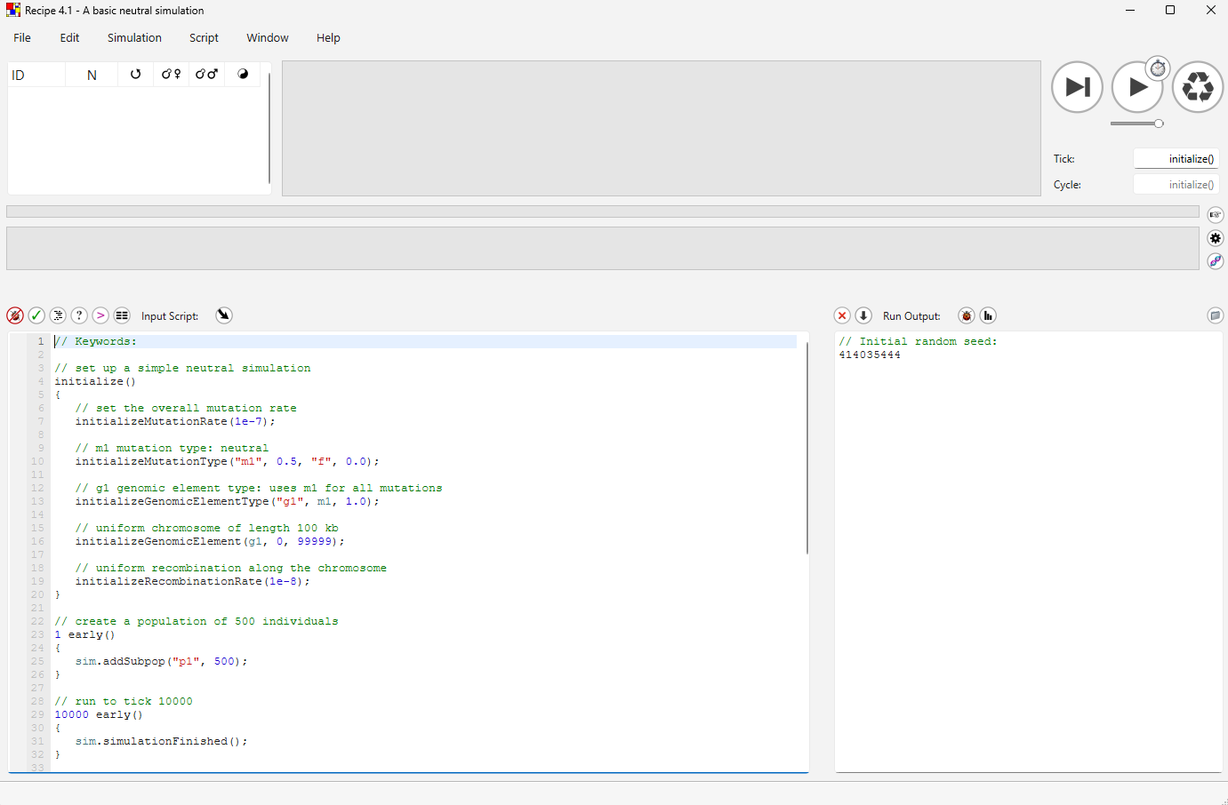
Notes:
Section break. From here it is one specific tool, and I want you to try it.

Slide 52
1
The scripting pane
Notes:
Section break. From here it is one specific tool, and I want you to try it.

Slide 53
1
2
The output pane
Notes:
Section break. From here it is one specific tool, and I want you to try it.

Slide 54
3
The population view
1
2
Notes:
Section break. From here it is one specific tool, and I want you to try it.

Slide 55
3
4
The individuals view
1
2
Notes:
Section break. From here it is one specific tool, and I want you to try it.

Slide 56
The tick controls
5
3
4
1
2
Notes:
Section break. From here it is one specific tool, and I want you to try it.

Slide 57
The tick controls
5
3
4
6
The chromosome view
1
2
Notes:
Section break. From here it is one specific tool, and I want you to try it.

Slide 58
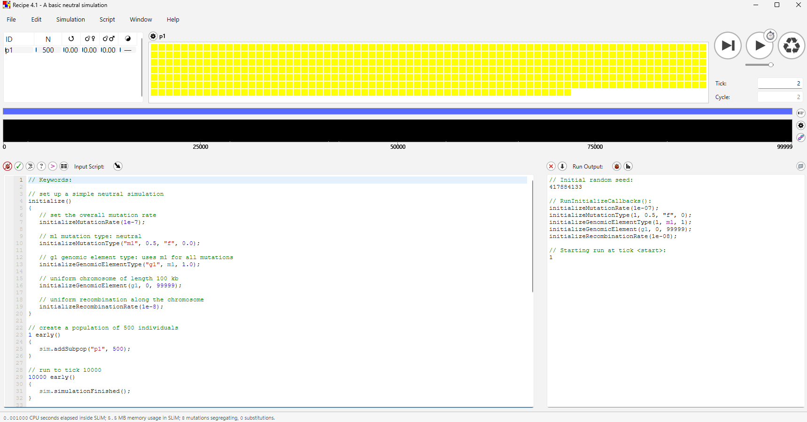
Notes:
Section break. From here it is one specific tool, and I want you to try it.

Slide 59
Notes:
Section break. From here it is one specific tool, and I want you to try it.

Slide 60
Notes:
Section break. From here it is one specific tool, and I want you to try it.

Slide 61
Notes:
Section break. From here it is one specific tool, and I want you to try it.

Slide 62
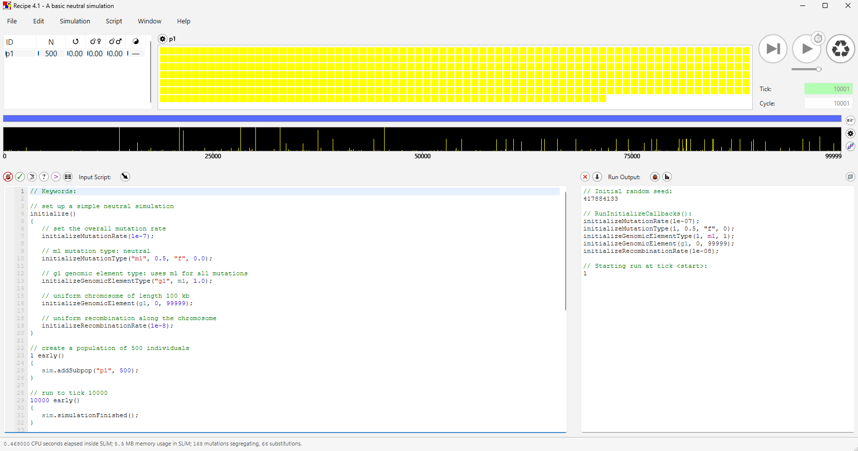
Notes:
Section break. From here it is one specific tool, and I want you to try it.

Slide 63
Notes:
Section break. From here it is one specific tool, and I want you to try it.

Slide 64
Method

Slide 65
Method
Gen 1
P1
P2
P3
Px

Slide 66
Method
Gen 2
P1
P2
P3
Px

Slide 67
Method
P1
P2
P3

Slide 68
Method
P1
P2
P3

Slide 69
Method
Gen x
P1
P2
Temperature (°C)
warmer
P3
Px
colder

Slide 70
Method
Gen x
P1
P2
Temperature (°C)
warmer
P3
Px
colder

Slide 71
Method
Gen x
P1
P2
Temperature (°C)
warmer
P3
Px
colder

Slide 72
Method
Gen x
P1
P2
Temperature (°C)
warmer
P3
Px
colder

Slide 73
Method
Gen x
P1
P2
Moisture
more
P3
Px
less

Slide 74
Method
Gen x
P1
P2
Elevation
more
P3
Px
less

Slide 75
Method
Gen x
P1
P2
Salinity
more
P3
Px
less

Slide 76
Method
Gen x
P1
P2
Etc.
more
P3
Px
less

Slide 77
Method
Extendible
Modifiable
No programming experience needed
Flexibility
SLiM manual §1.2, “Why SLiM?” — Haller & Messer.
Notes:
These are not my reasons, they are the authors' own, from section 1.2 of the manual. Flexibility: adding something complicated like epistasis or sequential mate choice is usually a couple of lines of script, rather than editing C++. Performance: they spent the months on optimisation so that you are not forced to shrink your population or narrow your parameter sweep. And the third one is the one people underrate — you can watch it, step through it, and poke at it while it runs. That is why it is learnable.

Slide 78
Method
Extendible
Modifiable
Little - No programming experience
Years of optimization
Large populations
Flexibility
Performance
SLiM manual §1.2, “Why SLiM?” — Haller & Messer.
Notes:
These are not my reasons, they are the authors' own, from section 1.2 of the manual. Flexibility: adding something complicated like epistasis or sequential mate choice is usually a couple of lines of script, rather than editing C++. Performance: they spent the months on optimisation so that you are not forced to shrink your population or narrow your parameter sweep. And the third one is the one people underrate — you can watch it, step through it, and poke at it while it runs. That is why it is learnable.

Slide 79
Method
Extendible
Modifiable
Little - No programming experience
Years of optimization
Large populations
Very simple scripting language
Visually clear
Flexibility
Performance
Simplicity
SLiM manual §1.2, “Why SLiM?” — Haller & Messer.
Notes:
These are not my reasons, they are the authors' own, from section 1.2 of the manual. Flexibility: adding something complicated like epistasis or sequential mate choice is usually a couple of lines of script, rather than editing C++. Performance: they spent the months on optimisation so that you are not forced to shrink your population or narrow your parameter sweep. And the third one is the one people underrate — you can watch it, step through it, and poke at it while it runs. That is why it is learnable.

Slide 80
Method
Extendible
Modifiable
Little - No programming experience
Years of optimization
Large populations
Very simple scripting language
Visually clear
Flexibility
Performance
Simplicity
“The end result is power and flexibility coupled with simplicity and reusability.”
SLiM manual §1.2, “Why SLiM?” — Haller & Messer.
Notes:
These are not my reasons, they are the authors' own, from section 1.2 of the manual. Flexibility: adding something complicated like epistasis or sequential mate choice is usually a couple of lines of script, rather than editing C++. Performance: they spent the months on optimisation so that you are not forced to shrink your population or narrow your parameter sweep. And the third one is the one people underrate — you can watch it, step through it, and poke at it while it runs. That is why it is learnable.

Slide 81
Method
1
Your first model
Notes:
And the ceiling is high. The tool you learn in an afternoon is the same tool that records the full genealogy of every chromosome, that simulates several interacting species at once, and that runs hundreds of replicates on a cluster. You do not outgrow it and have to start again somewhere else — which, given how much of research is learning tools, is worth quite a lot.

Slide 82
Method
1
2
Your first model
Several populations
Notes:
And the ceiling is high. The tool you learn in an afternoon is the same tool that records the full genealogy of every chromosome, that simulates several interacting species at once, and that runs hundreds of replicates on a cluster. You do not outgrow it and have to start again somewhere else — which, given how much of research is learning tools, is worth quite a lot.

Slide 83
Method
1
2
3
Your first model
Several populations
Complex interactions
Notes:
And the ceiling is high. The tool you learn in an afternoon is the same tool that records the full genealogy of every chromosome, that simulates several interacting species at once, and that runs hundreds of replicates on a cluster. You do not outgrow it and have to start again somewhere else — which, given how much of research is learning tools, is worth quite a lot.

Slide 84
Method
1
2
3
4
Your first model
Several populations
Complex interactions
Research projects
Notes:
And the ceiling is high. The tool you learn in an afternoon is the same tool that records the full genealogy of every chromosome, that simulates several interacting species at once, and that runs hundreds of replicates on a cluster. You do not outgrow it and have to start again somewhere else — which, given how much of research is learning tools, is worth quite a lot.

Slide 85
Method
1
2
3
4
Your first model
Several populations
Complex interactions
Research projects
The same tool, for any system / species.
Notes:
And the ceiling is high. The tool you learn in an afternoon is the same tool that records the full genealogy of every chromosome, that simulates several interacting species at once, and that runs hundreds of replicates on a cluster. You do not outgrow it and have to start again somewhere else — which, given how much of research is learning tools, is worth quite a lot.

Slide 86
4.My Project

Slide 87

My Project – Problem
Notes:
Back to the number from the beginning. Ninety-four per cent of those populations had their genetics inferred from a head count. Nobody has checked whether that inference survives a moving climate — and you cannot check it in the field, because you would need to know the answer already. That is my thesis, and it exists because simulation makes the question askable at all.

Slide 88

My Project – Problem
Notes:
Back to the number from the beginning. Ninety-four per cent of those populations had their genetics inferred from a head count. Nobody has checked whether that inference survives a moving climate — and you cannot check it in the field, because you would need to know the answer already. That is my thesis, and it exists because simulation makes the question askable at all.

Slide 89
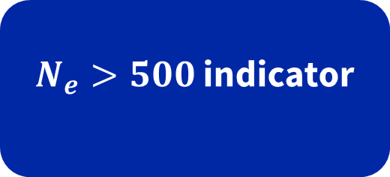
My Project – Problem
GBF Headline indicator A.4
$N_{e}>500$ indicator
Notes:
Back to the number from the beginning. Ninety-four per cent of those populations had their genetics inferred from a head count. Nobody has checked whether that inference survives a moving climate — and you cannot check it in the field, because you would need to know the answer already. That is my thesis, and it exists because simulation makes the question askable at all.

Slide 90

My Project – Problem
Signed by 196 countries
GBF Headline indicator A.4
$N_{e}>500$ indicator
Notes:
Back to the number from the beginning. Ninety-four per cent of those populations had their genetics inferred from a head count. Nobody has checked whether that inference survives a moving climate — and you cannot check it in the field, because you would need to know the answer already. That is my thesis, and it exists because simulation makes the question askable at all.

Slide 91


My Project – Problem
$$N_{c}$$
$$N_{e}$$
Notes:
Back to the number from the beginning. Ninety-four per cent of those populations had their genetics inferred from a head count. Nobody has checked whether that inference survives a moving climate — and you cannot check it in the field, because you would need to know the answer already. That is my thesis, and it exists because simulation makes the question askable at all.

Slide 92

My Project – Problem
$N_{e}$ = 1000

Slide 93

My Project – Problem
$N_{e}$ = 1000
$N_{e}$ = 500

Slide 94

My Project – Problem
$N_{e}$ = 1000
$N_{e}$ = 500
$N_{e}$ = 100

Slide 95
My Project - Solution
P1
P2
Temperature (°C)
warmer
P3
P4
colder
Notes:
Four populations across the Swiss Plateau — Geneva, Bern, Zurich, St. Gallen — each with its own temperature record from 1940 to 2025, and migration between them at a rate I set. Individuals carry a temperature optimum; the further they sit from what their site now demands, the fewer offspring they leave. Twelve treatments, twenty random seeds each, so 240 independent runs. Keep this short — the point of the talk is not my design.

Slide 96
My Project - Solution
P1
P2
4 populations
4 local climates
Migration
Real Climate data
Temperature (°C)
warmer
P3
P4
colder
Notes:
Four populations across the Swiss Plateau — Geneva, Bern, Zurich, St. Gallen — each with its own temperature record from 1940 to 2025, and migration between them at a rate I set. Individuals carry a temperature optimum; the further they sit from what their site now demands, the fewer offspring they leave. Twelve treatments, twenty random seeds each, so 240 independent runs. Keep this short — the point of the talk is not my design.

Slide 97
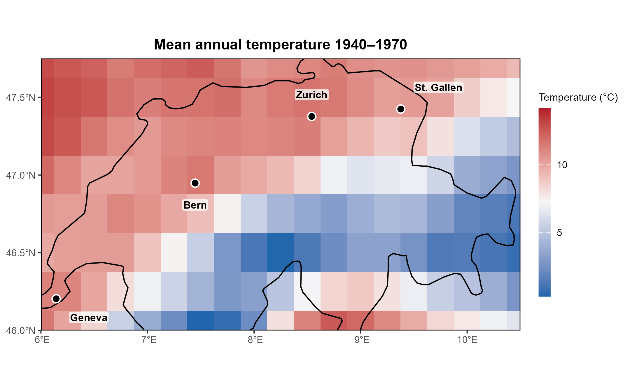
My Project - Method
Notes:
Four populations across the Swiss Plateau — Geneva, Bern, Zurich, St. Gallen — each with its own temperature record from 1940 to 2025, and migration between them at a rate I set. Individuals carry a temperature optimum; the further they sit from what their site now demands, the fewer offspring they leave. Twelve treatments, twenty random seeds each, so 240 independent runs. Keep this short — the point of the talk is not my design.

Slide 98
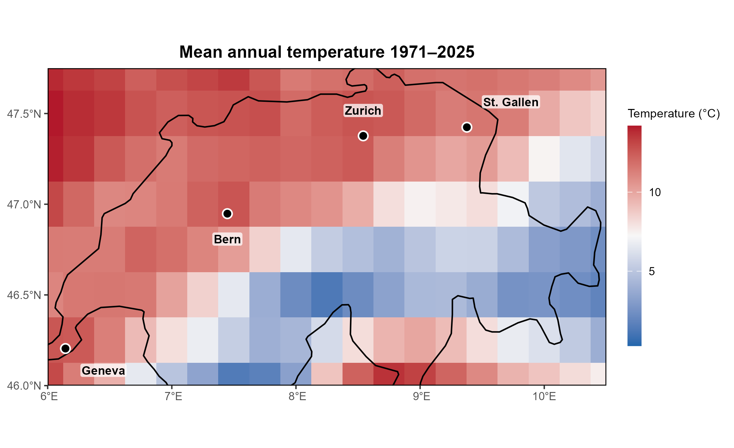
My Project - Method
Notes:
Four populations across the Swiss Plateau — Geneva, Bern, Zurich, St. Gallen — each with its own temperature record from 1940 to 2025, and migration between them at a rate I set. Individuals carry a temperature optimum; the further they sit from what their site now demands, the fewer offspring they leave. Twelve treatments, twenty random seeds each, so 240 independent runs. Keep this short — the point of the talk is not my design.

Slide 99
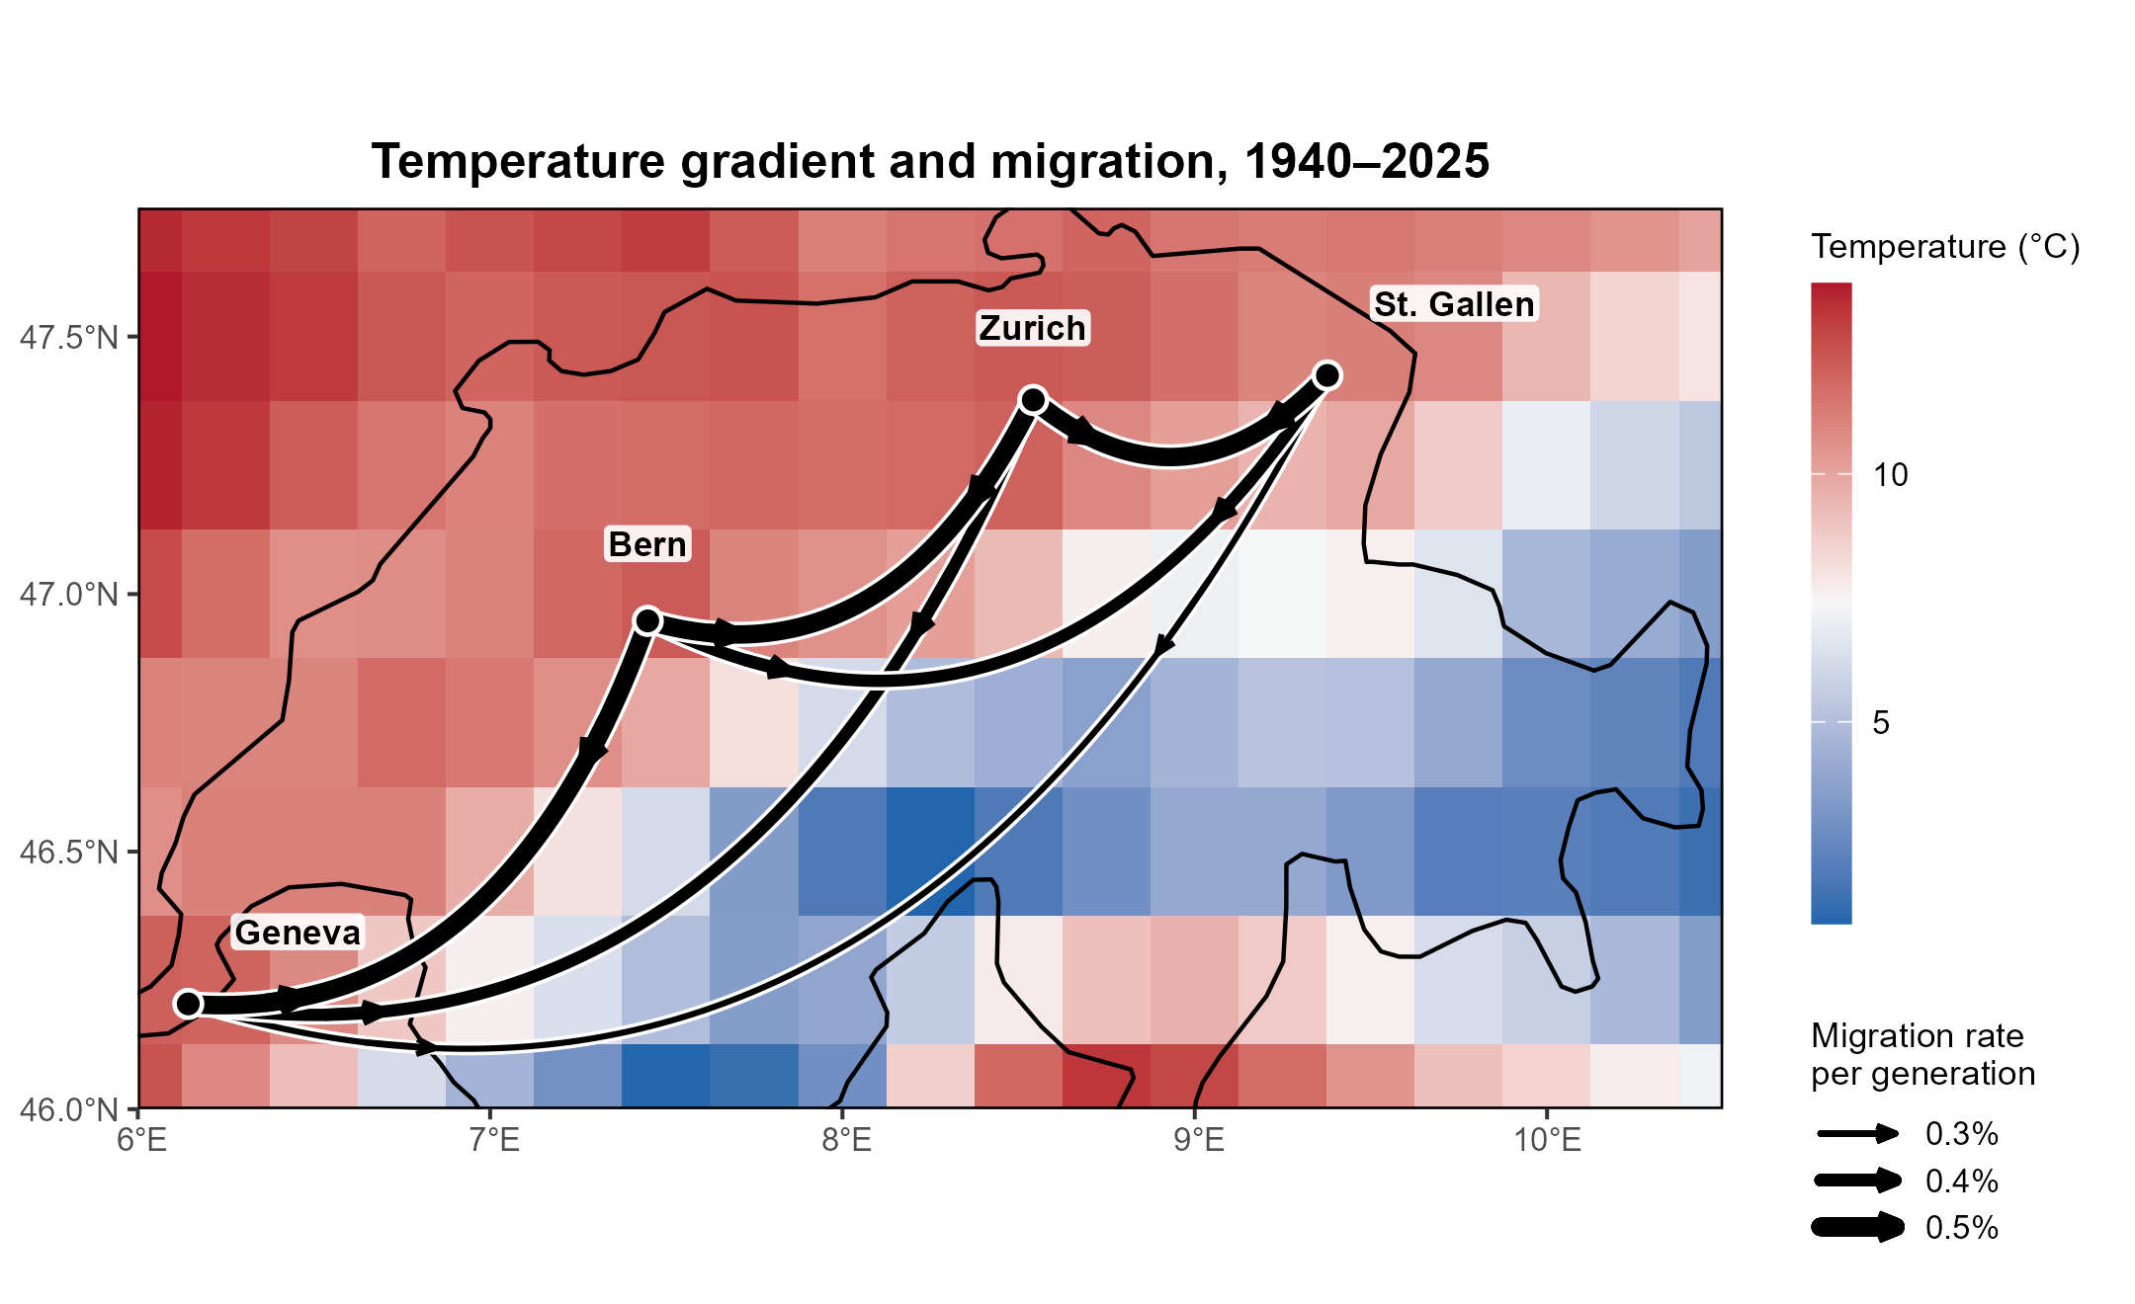
My Project - Method
Notes:
Four populations across the Swiss Plateau — Geneva, Bern, Zurich, St. Gallen — each with its own temperature record from 1940 to 2025, and migration between them at a rate I set. Individuals carry a temperature optimum; the further they sit from what their site now demands, the fewer offspring they leave. Twelve treatments, twenty random seeds each, so 240 independent runs. Keep this short — the point of the talk is not my design.

Slide 100
My Project - Method
Notes:
Four populations across the Swiss Plateau — Geneva, Bern, Zurich, St. Gallen — each with its own temperature record from 1940 to 2025, and migration between them at a rate I set. Individuals carry a temperature optimum; the further they sit from what their site now demands, the fewer offspring they leave. Twelve treatments, twenty random seeds each, so 240 independent runs. Keep this short — the point of the talk is not my design.

Slide 101
My Project - Method
Notes:
Four populations across the Swiss Plateau — Geneva, Bern, Zurich, St. Gallen — each with its own temperature record from 1940 to 2025, and migration between them at a rate I set. Individuals carry a temperature optimum; the further they sit from what their site now demands, the fewer offspring they leave. Twelve treatments, twenty random seeds each, so 240 independent runs. Keep this short — the point of the talk is not my design.

Slide 102
My Project - Result
Notes:
One preliminary result, to show you the shape of what comes out. Black is the actual number of individuals, collapsing. Orange is what a genetic estimate of effective size reports over the same period — essentially flat. Diversity-based measures integrate over the whole past, so they keep describing a healthy population long after it has crashed. Whether that holds across all 240 runs is the rest of my thesis. But notice what I could do here: watch a predictor fail, against a truth I already knew.

Slide 103

My Project - Result
Does $N_{e}$> 500 here…
Notes:
One preliminary result, to show you the shape of what comes out. Black is the actual number of individuals, collapsing. Orange is what a genetic estimate of effective size reports over the same period — essentially flat. Diversity-based measures integrate over the whole past, so they keep describing a healthy population long after it has crashed. Whether that holds across all 240 runs is the rest of my thesis. But notice what I could do here: watch a predictor fail, against a truth I already knew.

Slide 104

My Project - Result
Does $N_{e}$> 500 here…
Predict
$N_{e}$ > 500 here?
Extinction?
Suggestions…
Notes:
One preliminary result, to show you the shape of what comes out. Black is the actual number of individuals, collapsing. Orange is what a genetic estimate of effective size reports over the same period — essentially flat. Diversity-based measures integrate over the whole past, so they keep describing a healthy population long after it has crashed. Whether that holds across all 240 runs is the rest of my thesis. But notice what I could do here: watch a predictor fail, against a truth I already knew.

Slide 105
Final Word
Real
data
Simulated
data

Slide 106
Thank you
Billy Wallisch
Spatial Genetics of Ecosystems
Department of Geography
University of Zurich
Notes:
Questions.

Slide 107
Supplementary Materials
Notes:
Be honest about this, because someone will raise it if you are not. Real data is true — that is its entire advantage, and it is a big one. Simulated data is only ever as good as the assumptions you put in. But they are not rivals. Your field data is what sets the parameters, and the simulation is what tells you which measurement would actually be worth the field season. And when the model reproduces something you already observed, that is a check on the model. They strengthen each other.

Slide 108





My Project – Problem
$$H(t) = H₀ × (1 − 1/(2·Ne))^t$$
$N_{e}$= 1000
$N_{e}$= 500
Adapted from Willi et al. 2021
Notes:
Back to the number from the beginning. Ninety-four per cent of those populations had their genetics inferred from a head count. Nobody has checked whether that inference survives a moving climate — and you cannot check it in the field, because you would need to know the answer already. That is my thesis, and it exists because simulation makes the question askable at all.

Slide 109
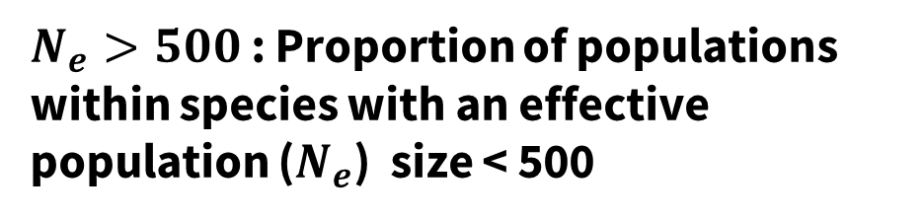
My Project – Problem
$N_{e}>500$ : Proportion of populations within species with an effective population ($N_{e}$) size < 500
Notes:
Back to the number from the beginning. Ninety-four per cent of those populations had their genetics inferred from a head count. Nobody has checked whether that inference survives a moving climate — and you cannot check it in the field, because you would need to know the answer already. That is my thesis, and it exists because simulation makes the question askable at all.

Slide 110

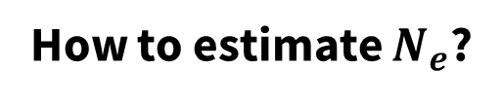

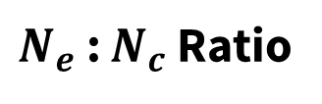
My Project – Problem
How to estimate $N_{e}$?
With genetic data:
Without genetic data:
$N_{e}$ : $N_{c}$ Ratio
Sample individuals
Sequence Genomes
$N_{e}$ Estimation
$N_{e}$ : $N_{c}$ Ratio ~ 0.10
Notes:
Back to the number from the beginning. Ninety-four per cent of those populations had their genetics inferred from a head count. Nobody has checked whether that inference survives a moving climate — and you cannot check it in the field, because you would need to know the answer already. That is my thesis, and it exists because simulation makes the question askable at all.

Slide 111




My Project – Problem
$$N_{e}>500$$
$$N_{e}<500$$
$$N_{e}>500$$
$$N_{e}<500$$
Notes:
Back to the number from the beginning. Ninety-four per cent of those populations had their genetics inferred from a head count. Nobody has checked whether that inference survives a moving climate — and you cannot check it in the field, because you would need to know the answer already. That is my thesis, and it exists because simulation makes the question askable at all.

Slide 112
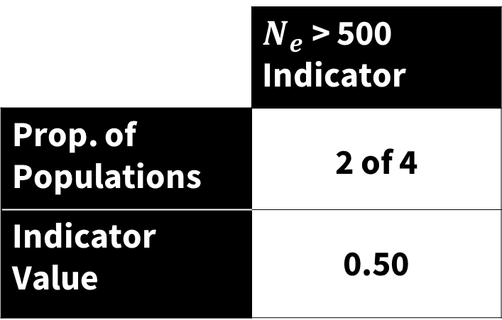



My Project – Problem
$$N_{e}>500$$
$$N_{e}<500$$
$$N_{e}>500$$
 | $N_{e}$ > 500 Indicator
Prop. of Populations | 2 of 4
Indicator Value | 0.50
$$N_{e}<500$$
Notes:
Back to the number from the beginning. Ninety-four per cent of those populations had their genetics inferred from a head count. Nobody has checked whether that inference survives a moving climate — and you cannot check it in the field, because you would need to know the answer already. That is my thesis, and it exists because simulation makes the question askable at all.

